Slide 1
Classification & RQO determination of water resources in the Inkomati Water Management Area
Public meeting
12 June 2013
BACKGROUND TO THE STUDY
1
Notes:
GLeWaP - May 2010
1

Slide 2
PROJECT PLAN AND STUDY TASKS
The study has a duration of two years ending April 2015.
Two processes are involved, namely
  Classification of the Water Resource
  Resource Quality Objectives
The study will be carried out in distinct steps following a prescribed process
The aim of the project is to determine the Class of the water resources on the Inkomati WMA

Slide 3
The Study Area
The study area consists of the Inkomati Water Management Area.
There are three distinct and largely independent catchments in the WMA:
  The Komati River
  The Crocodile River, and
  The Sabie River

Slide 4
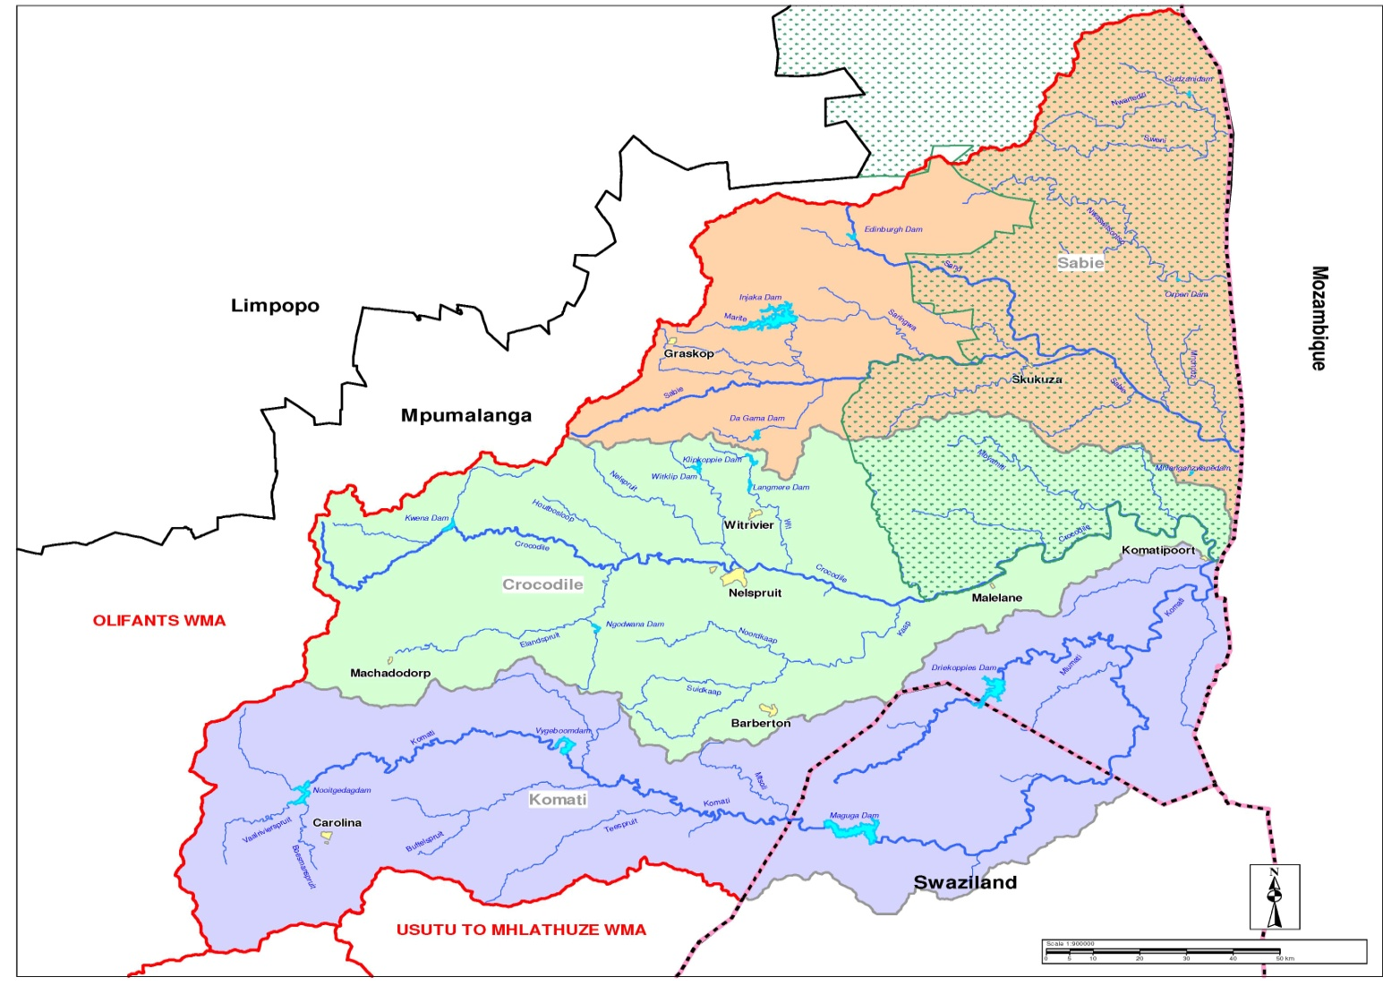

Slide 5
PROJECT PLAN AND STUDY TASKS
TECHNICAL STEPS
OTHER STEPS
1. Status quo, catchment delineation
Stakeholder
process
Capacity building
3. Quantify Ecological Water Requirement & links to Ecological goods and Services
Visioning
7. Gazetting
4&5. Develop & evaluate scenarios in IWRM
6. RQO

Slide 6
Status Quo
The Status Quo of the Inkomati will be determined during the first 3 months of this study and described in a report.
The Status Quo will cover the following aspects:
  Water Resources
  Water Quality
  Economy
  Ecology
  Ecosystem services
Based on information available from previous studies, a brief overview of the Status Quo of the Inkomati is provided here:

Slide 7
Water Resources

Slide 8
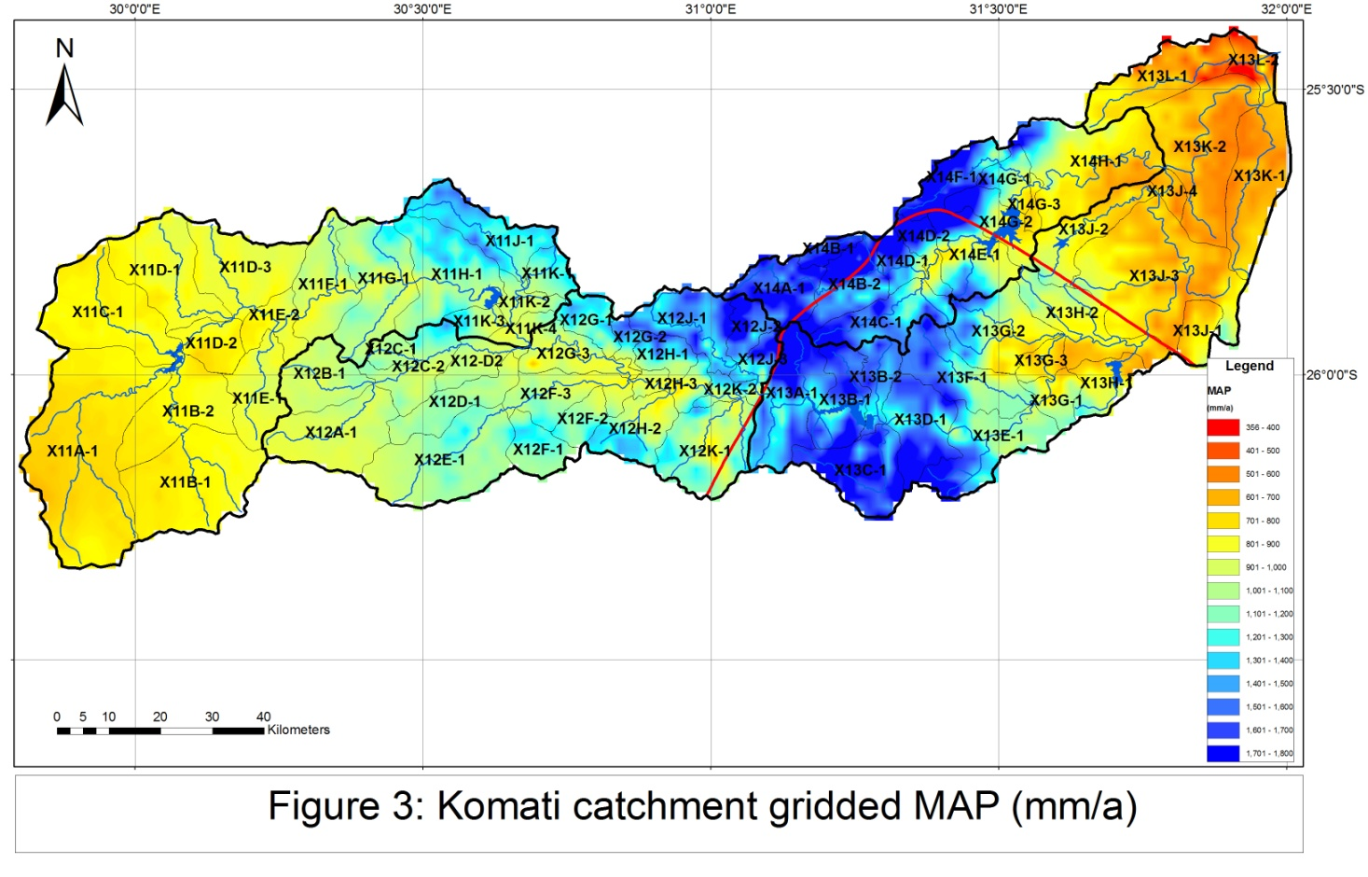
Komati

Slide 9
Komati
  The Komat catchment has an interesting location in that it rises upstream of Swaziland, flows through Swaziland, and back into South Africa.
  The Komati catchment has relatively high rainfall (500 to over 1 600 mm/annum)
  The Mean Annual runoff from the catchment is estimated to be 1 357 million m³/annum

Slide 10
Summary of water use
Water use in the Komati catchment is estimated to be as follows:
Sector | Allocation (million m³/annum) | Actual use (million m³/annum)
Domestic | 88 | 21
Strategic | 106 | 106
Industrial | 11 | 11
Irrigation | 642 | ~ 500
Total | 847 | 638

Slide 11
There are significant transfers out of the Komati catchment:
  ~100 million m3/a to the Olifants catchment
  ~170 million m3/a to the Mbuluzi catchment
  ~ 9 million m3/a to the Crocodile catchment

Slide 12
Dams
Significant dams in the catchment are:
  Nooitgedacht
  Vygeboom
  Maguga (located in Swaziland)
  Driekoppies
  Lomati
  Shiyalongubo

Slide 13
Land use activities
In addition to direct abstractions, there is an estimated 1 203 Km² of forestry in the Komati catchment.
This reduces the runoff from the catchment by an estimated 117 million m³ /annum.

Slide 14
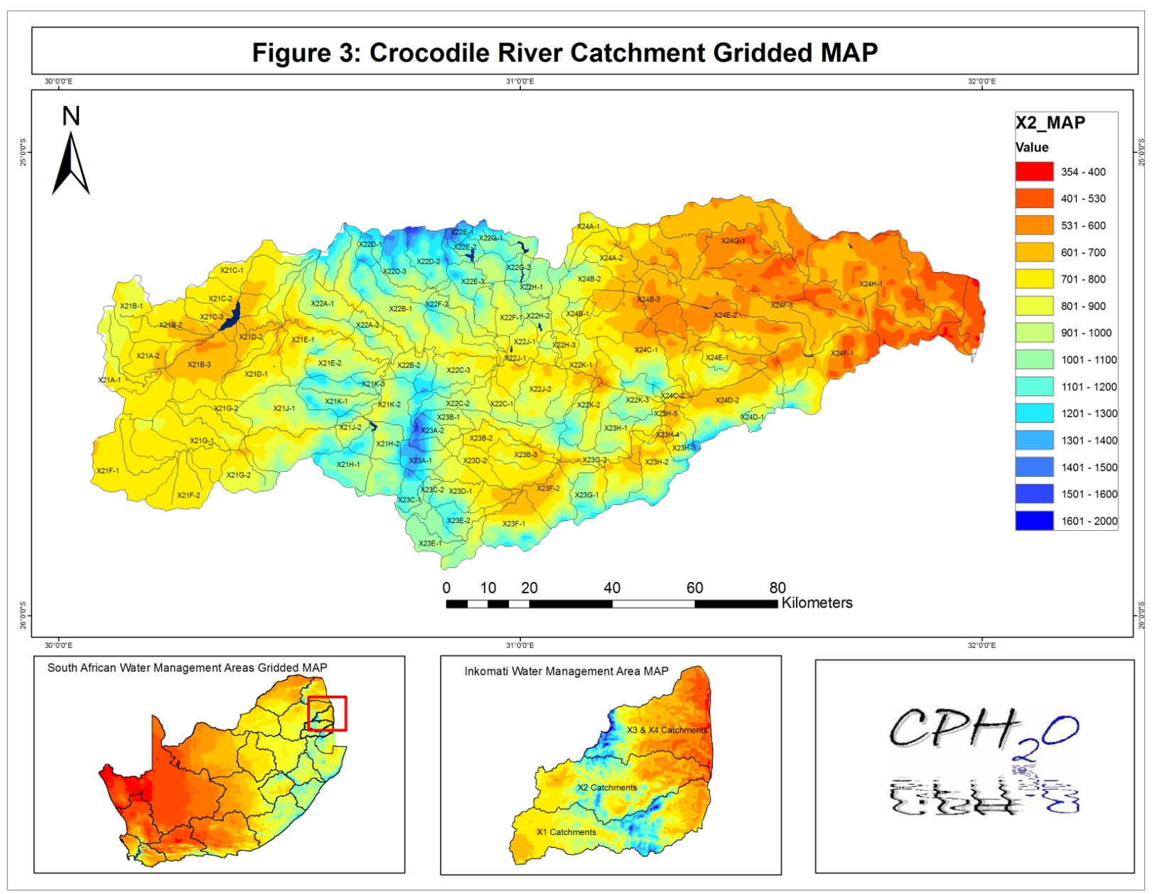
Crocodile

Slide 15
Overview of the Crocodile catchment
The Crocodile catchment also has relatively high rainfall (450 to over 1 400 mm/annum)
The Mean Annual runoff from the catchment is estimated to be 1 136 million m³/annum

Slide 16
Crocodile catchment
Water use in the Crocodile is also dominated by irrigation but domestic and industrial use are also significant.

Slide 17
Dams
Significant dams in the Crocodile catchment are:
  Kwena
  Ngodwana
  Witklip
  Klipkopjes
  Longmere
  Primkop

Slide 18
Landuse activities
In addition to direct abstractions, there is an estimated 1 941 Km² of forestry in the Crocodile catchment.
This reduces the runoff from the catchment by an estimated 157 million m³ /annum.

Slide 19
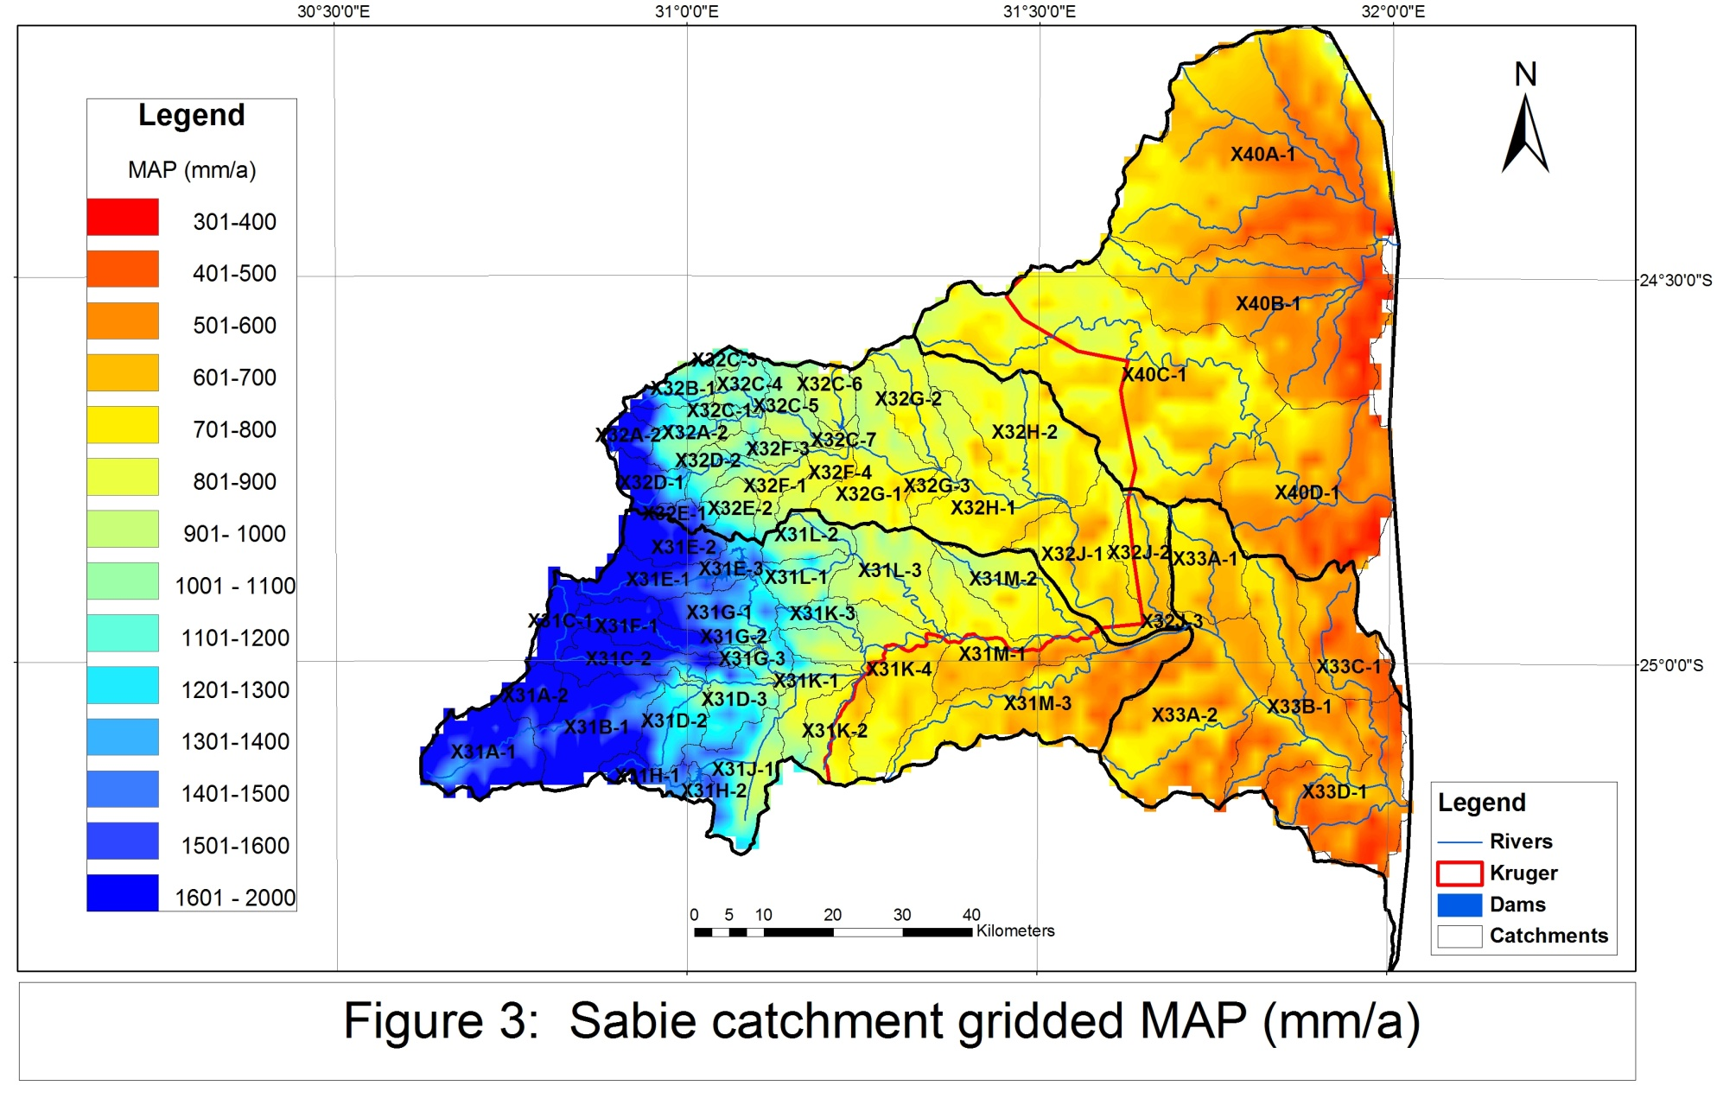
Sabie

Slide 20
Overview of the Sabie catchment
The Sabie catchment also has relatively high rainfall (500 to over 1 600 mm/annum)
The Mean Annual runoff from the catchment is estimated to be 676 million m³/annum

Slide 21
Sabie catchment
Water use in the Sabie is also dominated by irrigation but domestic use has grown dramatically over the last 10 years

Slide 22
Dams
Significant dams in the Sabie catchment are:
  Inyaka
  Da Gama

Slide 23
Landuse activities
In addition to direct abstractions, there is an estimated 853 Km² of forestry in the Sabie catchment.
This reduces the runoff from the catchment by an estimated 95 million m³ /annum.

Slide 24
SUMMARY AND CONCLUSION
(WATER RESOURCES)
  The Inkomati WMA is well endowed with water
  However, due to rapid development since the 80’s the water resource is fully utilised in the Komati and Crocodile catchments
  The water resource in the Sabie catchment is not yet fully utilised but has been fully allocated. These allocations will be taken up shortly to improve delivery of water services in the Sand River catchment.

Slide 25
Water Quality
  Several of the recent studies have analysed the water quality situation, although not in great detail.
  From these studies, the problem areas in the Inkomati are known. They are:
    Lower Elands River (SAPPI effluent)
    Upper Komati (AMD)
    Middle Crocodile (Nelspruit urban effluent)
  Modelling of these problem areas will be undertaken if it will add value to the project

Slide 26
Economy
  The economy will be evaluated in terms of the contribution to GDP and employment creation within each zone
  The value of water to each sector will be evaluated
  The impact of scenarios can then be evaluated socio-economic terms
  This work was done as part of previous studies but will be updated as part of this Classification Study

Slide 27
Ecology
The ecological Reserve has been determined throughout the Inkomati WMA
The determination of the Komati River was completed in 2006 while that of the Crocodile and Sabie was completed in 2010.
In general, the ecology of the rivers in the Inkomati are in a good state with many undeveloped catchments in a near to pristine state.

Slide 28
Possible problem areas are:
  The lower Komati downstream of the confluence with the Lomati River
  The lower reaches of the Crocodile River
  The high ecological catgegory assigned to the Sabie River (A/B) will become increasingly difficult to maintain with increasing domestic water requirements.
  Pressure to reinstate forestry and re-vitalise irrigation in the Sand River will put the ecology of this river under stress.

Slide 29
The Present Ecological State of all river reaches in the Inkomati WMA have been determined at a fine resolution as part of a previous project.
This will be used as a starting point as part of this Classification process.

Slide 30
Ecosystem Services
Ecosystem Services considers benefits that rural communities can derive directly from the river.
These can be categorised as provisioning services:
  Fishing
  Riparian trees and shrubs
  Medicinal herbs and plants
  Grazing in the riparian zone
  Crop cultivation in the flood plain
  Fibres for making baskets and mats

Slide 31
Cultural services, such as
  Cultural and ritual use of rivers
  Aesthetic or historical importance
Regulating services
  Water quality

Slide 32
PROJECT PLAN AND STUDY TASKS
TECHNICAL STEPS
OTHER STEPS
1. Status quo, catchment delineation
5 stakeholder process
7 capacity building
3. Quantify Ecological Water Requirement & links to Ecological goods and Services
2. Visioning
8. Gazetting
4. Develop & evaluate scenarios in IWRM
6. RQO

Slide 33
DELINEATE THE CATCMENT INTO INTEGRATED UNITS OF ANALSYIS
WATER RESOURCES
WATER QUALITY
ECOLOGY
ECONOMY
EGSA
INTEGRATE,
OVERLAY,
DEFINE IUAs
ZONES OF SIMILAR STATE AND LAND USE THAT CAN BE MANAGED AS ONE ENTITY

Slide 34
PRELIMINARY INTEGRATED UNITS OF ANALYSIS
Based on a preliminary catchment delineation, we have:
  37 preliminary IUAs
    9 in the Komati
    14 in Crocodile
    15 in the Sabie/Sand

Slide 35
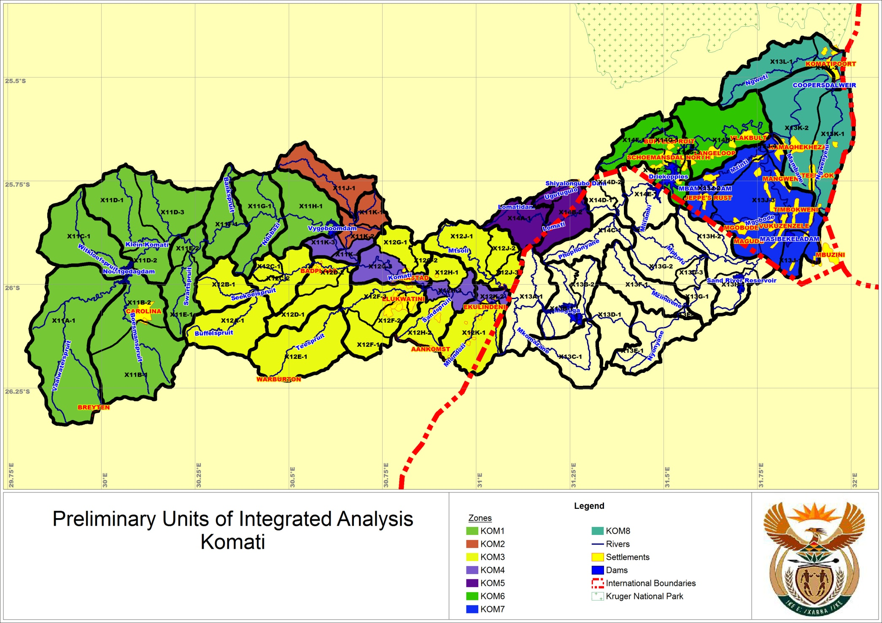
Komati

Slide 36
Komati IUAs
KOM1:
This IUA consists of the catchment upstream of the Vygeboom dam and includes the Nooitgedacht Dam. Water is transferred from these dams to power stations in the Olifants catchment. There are several coal mines in this catchment and acid mine drainage is impacting negatively on the water quality of the catchment, especially the upper reaches where towns such as Carolina rely on the water resource.
There is limted irrigation and forestry in this IUA.

Slide 37
KOM2
This IUA consists of the Gladdespruit catchment which is a major tributary of the Komati River. This IUA is charaterised by large areas of forestry. There is a large Nickel mine in this catchment and limited irrigation. Surplus water from this catchment is diverted into the Vygeboom Dam contributing to the yield of this dam.

Slide 38
KOM3
The remaining major tributaries (Teesrpuit, Seekoeisrpuit, Buffelsspruit, Mtosoli and Mlondizi) of the Komati River comprise this IUA. There are significant areas of forestry in the high-lying areas of these catchments and rural development in the lower reaches. There is limited irrigation in this IUA.

Slide 39
KOM4
The main stem of the Komati River downstream of the Vygeboom Dam and down to the border with Swaziland. The rapidly expanding villages and towns in the area are dependant on water from this river reach. There is limited irrigation in this IUA.

Slide 40
KOM5
The Lomati River upstream of Swaziland. There are two significant dams in this IUA, the Lomati and Shialongubu dams. Water is transferred from these dams to the Kaap River. There is a significant amount of forestry in the IUA.

Slide 41
KOM6
The Lomati River downstream of Swazilamd. This IUA included the Driekoppies Dam and is charecterised by large areas of irrigation (mostly sugarcane) supplied from the Driekoppies Dam. There are also siginificant domestic water requirements in the IUA.

Slide 42
KOM7
The Komati River downstream of Swaziland. This IUA has large areas of irrigation supplied mostly from Maguga dam. There are also significant domestic water requirements in the IUA.

Slide 43
KOM8
This IUA lies downstream of the confluence of the Lomati and Komati River. The large areas of irrigation in this area can receive water from either the Driekoppies or Maguga Dams. There are a large number of weirs constructed on this river reach. There is a minimum flow rquirement from this IUA to meet international requirements.

Slide 44
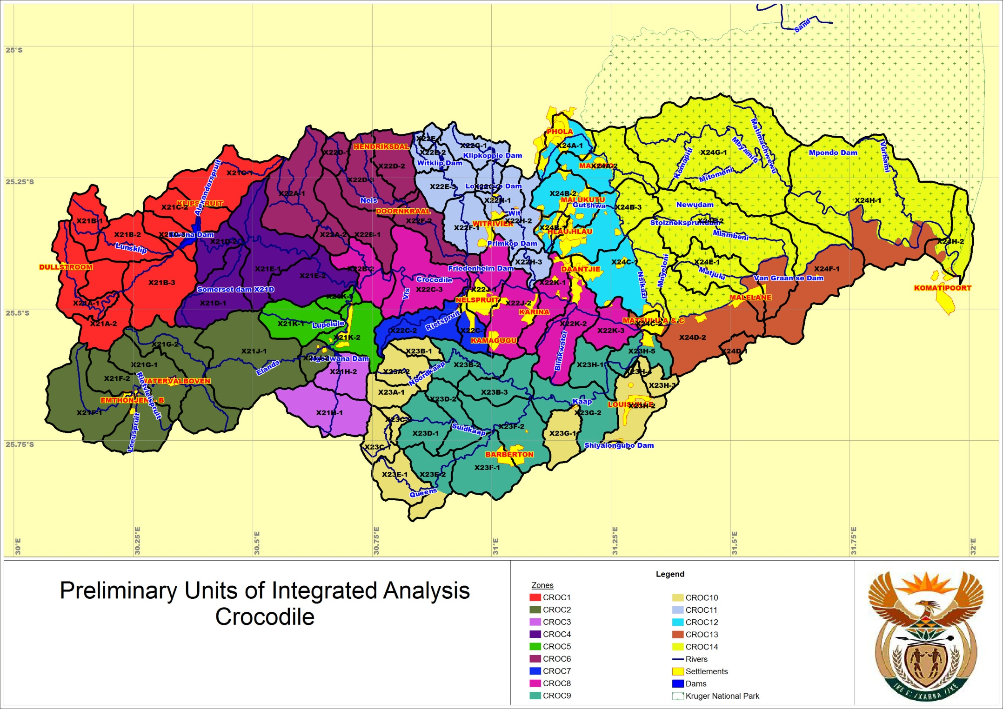
Crocodile

Slide 45
CROC1
This IUA consists of the catchment of the Kwena Dam. There are significant areas of forestry in this IUA but limited irrigation. There are a large number of trout dams in this catchment which could create water quality issues.

Slide 46
CROC2
The upper reaches of the Elands River up to the Ngodwana paper mill. There are large areas of forestry in this IUA but limited irrigation. Domestic use is limited. The smelter located near Machadodorp is a concern with regard to water quality.

Slide 47
CROC3
This IUA consists of the catchment of the Ngodwana River and contains the Ngodwana Dam. There are large areas of forestry in the IUA.

Slide 48
CROC4
The Crocodile River downstream of the Kwena Dam to the confluence with the Eland River. This IUA has siginificant areas of forestry in the high-lying areas and irrigation in the valley, supported by releases from the Kwena Dam.

Slide 49
CROC5
The Elands River downstream of the Ngodwana paper mill. Due to effluent discharged into the Elands River by the paper mill, this river reach has water quality concerns. There are siginifcant areas of forestry and limited irrigation in this IUA.

Slide 50
CROC6
This IUA contains two major tribuatries of the north of the Crocodile River, namely the Houtbosloop and the Nels River. Both these tributaries are characterised by large areas of irrigation and forestry.

Slide 51
CROC7
The tributaries to the south of the Crocodile river comprise this IUA and contains the town of Nelspruit. There are significant areas of forestry and limited irrigation. Urban and industrial development is impacting on the water quality of the receiving Crocodile River.

Slide 52
CROC8
The main stem of the Crocodile River downstream of the confluence with the Elands River to the confluence with the Kaap River. This IUA is charaCterised by large areas of irrigation supported by releases from the Kwena Dam. There are also large abstractions for domestic use from this river reach. Due to the discharge of domestic effluent in this river reach, water quality is a concern.

Slide 53
CROC9
The main stem of the Kaap River, characterised by large areas of irrigation supplied from run-of-river.

Slide 54
CROC10
The headwater tributaries of the Kaap River characeterised by large areas of forestry.

Slide 55
CROC11
The White River catchment which inlcudes the town of White River and the Witklip, Klipkopjes, Longmere and Primkop dams. This catchment is highly developed with irrigation but there are also significant areas of forestry in the upper reaches. Due to the urban and industrial development, water quality is a concern.

Slide 56
CROC12
This IUA consists of the Nsikasi River, a tributary of the Crocodile River. Irrigation and forestry in the IUA are insignificant since it is dominated by urban/rural development. Water supply to this area is problematic and water quality is a concern.

Slide 57
CROC13
The main stem of the Crocodile River donstream of the confluence with the Kaap. There are large areas of irrigation in the IUA supported by releases from the Kwena Dam.

Slide 58
CROC14
This IUA includes all the areas that lie within the Kruger National Park.

Slide 59
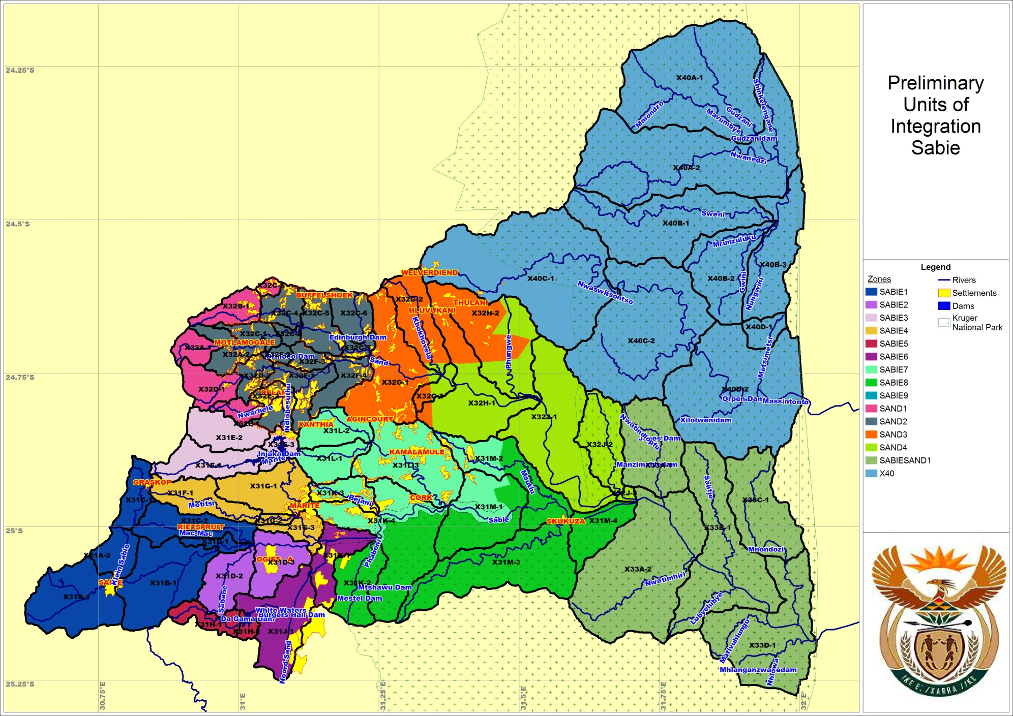
Sabie

Slide 60
SABIE1
The upper reaches of the Sabie River. This IUA is characterised by large area of forestry and very little other development.

Slide 61
SABIE2
This IUA consists of the areas of the upper Sabie to the confluence with the Marite River that are highly developed in terms of irrigation and includes the Sabaan River, a tributary of the Sabie. Irrigators obtain their water from the Sabie River and from the numerous farm dams in this IUA.

Slide 62
SABIE3
The catchment of the Inyaka Dam. This IUA contains large areas of forestry but limited irrigation. In addition to the Inyaka Dam, the catchment also contains the smaller Maritsane Dam.

Slide 63
SABIE4
The catchment downstream of the Inyaka Dam including the Motitisi River. This IUA also contains large areas of forestry but limited irrigation. There is significant rural development in the IUA with water requirements supplied from the Inyaka Dam.

Slide 64
SABIE5
The catchment of the Da Gama Dam. There are large areas of forestry in this IUA but no other development.

Slide 65
SABIE6
The catchment downstream of the Da Gama. There are signifcant areas of irrigation in this IUA, supplied from the Da Gama Dam. There are also large areas of rural development with problematic water supply. The rural water requirements are supplied from the Sabie River.

Slide 66
SABIE7
This IUA consists of the drier tributaries to the Sabie outside of the Kruger National Park. These tributaries include the Benjani and Saringwa rivers. The areas is too dry for forestry or irrigation. There are a number of villages in the IUA with problematic water supply.

Slide 67
SABIE8
This IUA consists of the catchments within the Kruger National Park.

Slide 68
SABIE9
The main stem of the Sabie River, which supports large abstraction for domestic use as well as irrigation.

Slide 69
SAND1
This IUA consists of the high-lying regions of the Sand River catchment. There were large areas of forestry in this area but much of this was removed in the late 90s. There are now plans to replant about 4 000ha of this forestry. The tributaries rising in this area are all perennial with high base flows and sustain the flow through the Sand River into the Kruger National Park.

Slide 70
SAND2
The area immediately downstream of the SAND1 IUA comprise this IUA and is characterised by large scale rural development and some irrigation supplied from run-of-river flows. The domestic water requirements have been met from run-of-river abstractions and groundwater in the past but are now being replaced by water supplied from the Inyaka Dam.

Slide 71
SABIESAND1
The area downstream of SAND2 which consists of private game farms.

Slide 72
X40
This IUA consists of the X40 catchment. This area also lies within the Kruger National Park but does not have the benefit of the large natural base flow derived from the Sabie catchment.

Slide 73
CONSEQUENCES OF OPERATIONAL SCENARIOS
Define operational SCs
Yield modelling
Predict Consequences
Non-Ecological Water quality
Ecological
EGSA
Economics
Rank, optimise, recommend Scenario
Define MC (and catchment configuration)
Test with stakeholders

Slide 74
Resources Quality Objectives
The determination of resources quality objectives follows the same multi-step process of Classification.
The outcome of RQO is the Ecological classification and the Ecological Specification

Slide 75
Visioning
Visioning is a required step in both the Classification and the Resource Quality Objectives process.
Visioning is a process of ‘articulating society’s aspirations for the future of the Inkomati WMA’
Hence, visioning is required to find out how stakeholders see the future of the Inkomati WMA in terms of the trade-off between growth and development on the one hand and ecological protection on the other.

Slide 76
While visioning was done on a broad scale as part of the Catchment Management Strategy, it now needs to be done at a finer scale for Classification.
The scale at which visioning is done for Resource Classification are so-called ‘Integrated Units of Analysis’.
These are determined jointly by establishing units with similar characteristics for the following categories:
  Water resources management
  Economic
  Water Quality
  Ecology
  Social aspects (goods and services)

Slide 77
Ultimately a Water Resources Class will be determined for each of these units following a rigorous stakeholder process.
A questionaire and information document has been made available for stakeholders to give their input into the visioning relating to each of the IUA.

Slide 78
Summary and conclusions
The purpose of this study is to determine the class of the water resource.
A class which maximises environmental protection (Class 1) will entail less water for growth and development with possible associated consequences (reduced economic growth, less jobs)
A class which minimises environmental protection (Class 3) will maximise water for growth and development but will impact on goods and services for riparian users, the ecology of the river and eco-tourism.

